Slide 1
HYPE360
Marketing Made Easier !

Slide 2
Flutter App + Web Dashboard for Aggregating Local Businesses with Freelance Digital Marketers
PROBLEM DEFINITION

Slide 3

“I wish to grow my business and increase my sales. What kind of marketing do I need?.”
- Susan Colins ( LOCAL BAKER )

Slide 4
WHY Susan’s BAKERy NEEDS DIGITAL MARKETING ?
Statistics Say…
63 Million SMEs (Small – Medium Enterprises) in India according to FY20 Reports
Each day Increased Number of Social Media Users
120 Million Indian Users on Instagram
320 Million Indian Users on Facebook
Average 145 minutes per day on Social Media per User

Slide 5
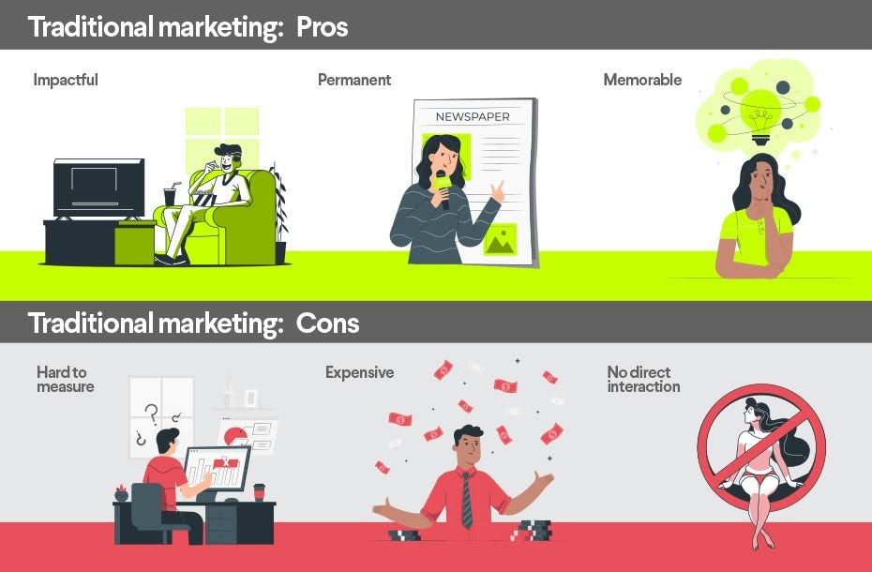
Traditional VS DIGITAL MARKETING
Traditional marketing channels include:
Outdoor (Billboards, bus/taxi wraps, posters etc)
Broadcasting (TV, Radio etc)
Print (Magazines, newspapers etc)
Direct Mail (catalogues etc)
Telemarketing (Phone, text message)
Window display and signs

Slide 6
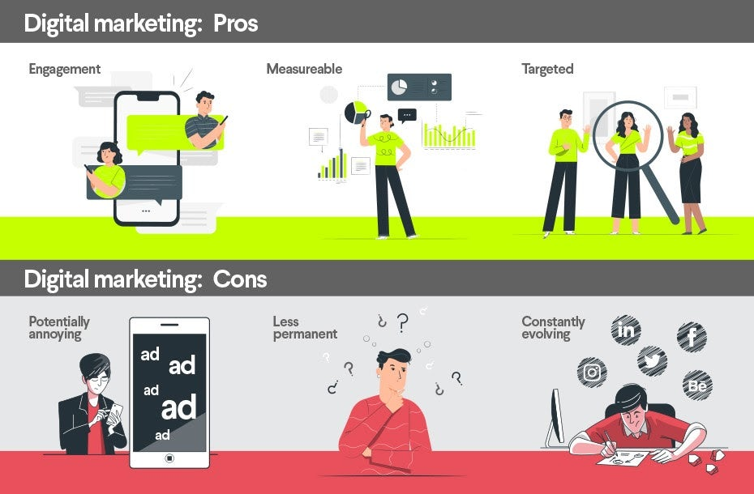
Traditional VS DIGITAL MARKETING
Social media (Facebook, Instagram etc.)
Website
Content marketing
Affiliate marketing
Social Media marketing
Email marketing
PPC (pay per click)
SEM (Search engine marketing)

Slide 7

SUSAN’s OPTIONS FOR DIGITAL MARKETING ?
DIGITAL MARKETING AGENCY
Expensive for small businesses
On an average $ 270 – $ 400 per Month
FREELANCE DIGITAL MARKETERS
Where to connect ?!
Trust and Availability is a concern
On an average $ 10 - $ 50
DO IT YOURSELF
Understand the system
Must use pre-set boosting and promotion options on Social Media
Unavailability of personalized marketing ( target specific audience )
Increased Management Overhead

Slide 8

EUREKA !
I FOUND IT !!
Susan : Amy do you have any suggestions?
Amy : You should check out HYPE360

Slide 9

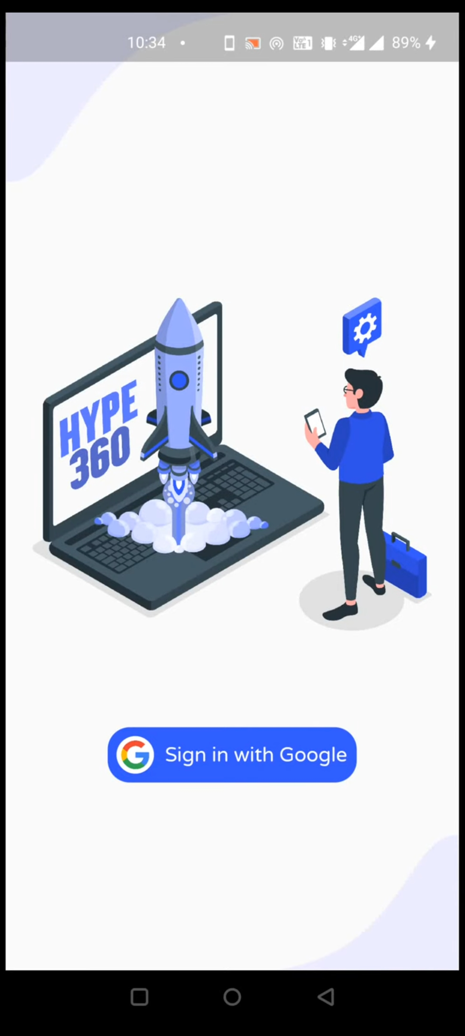
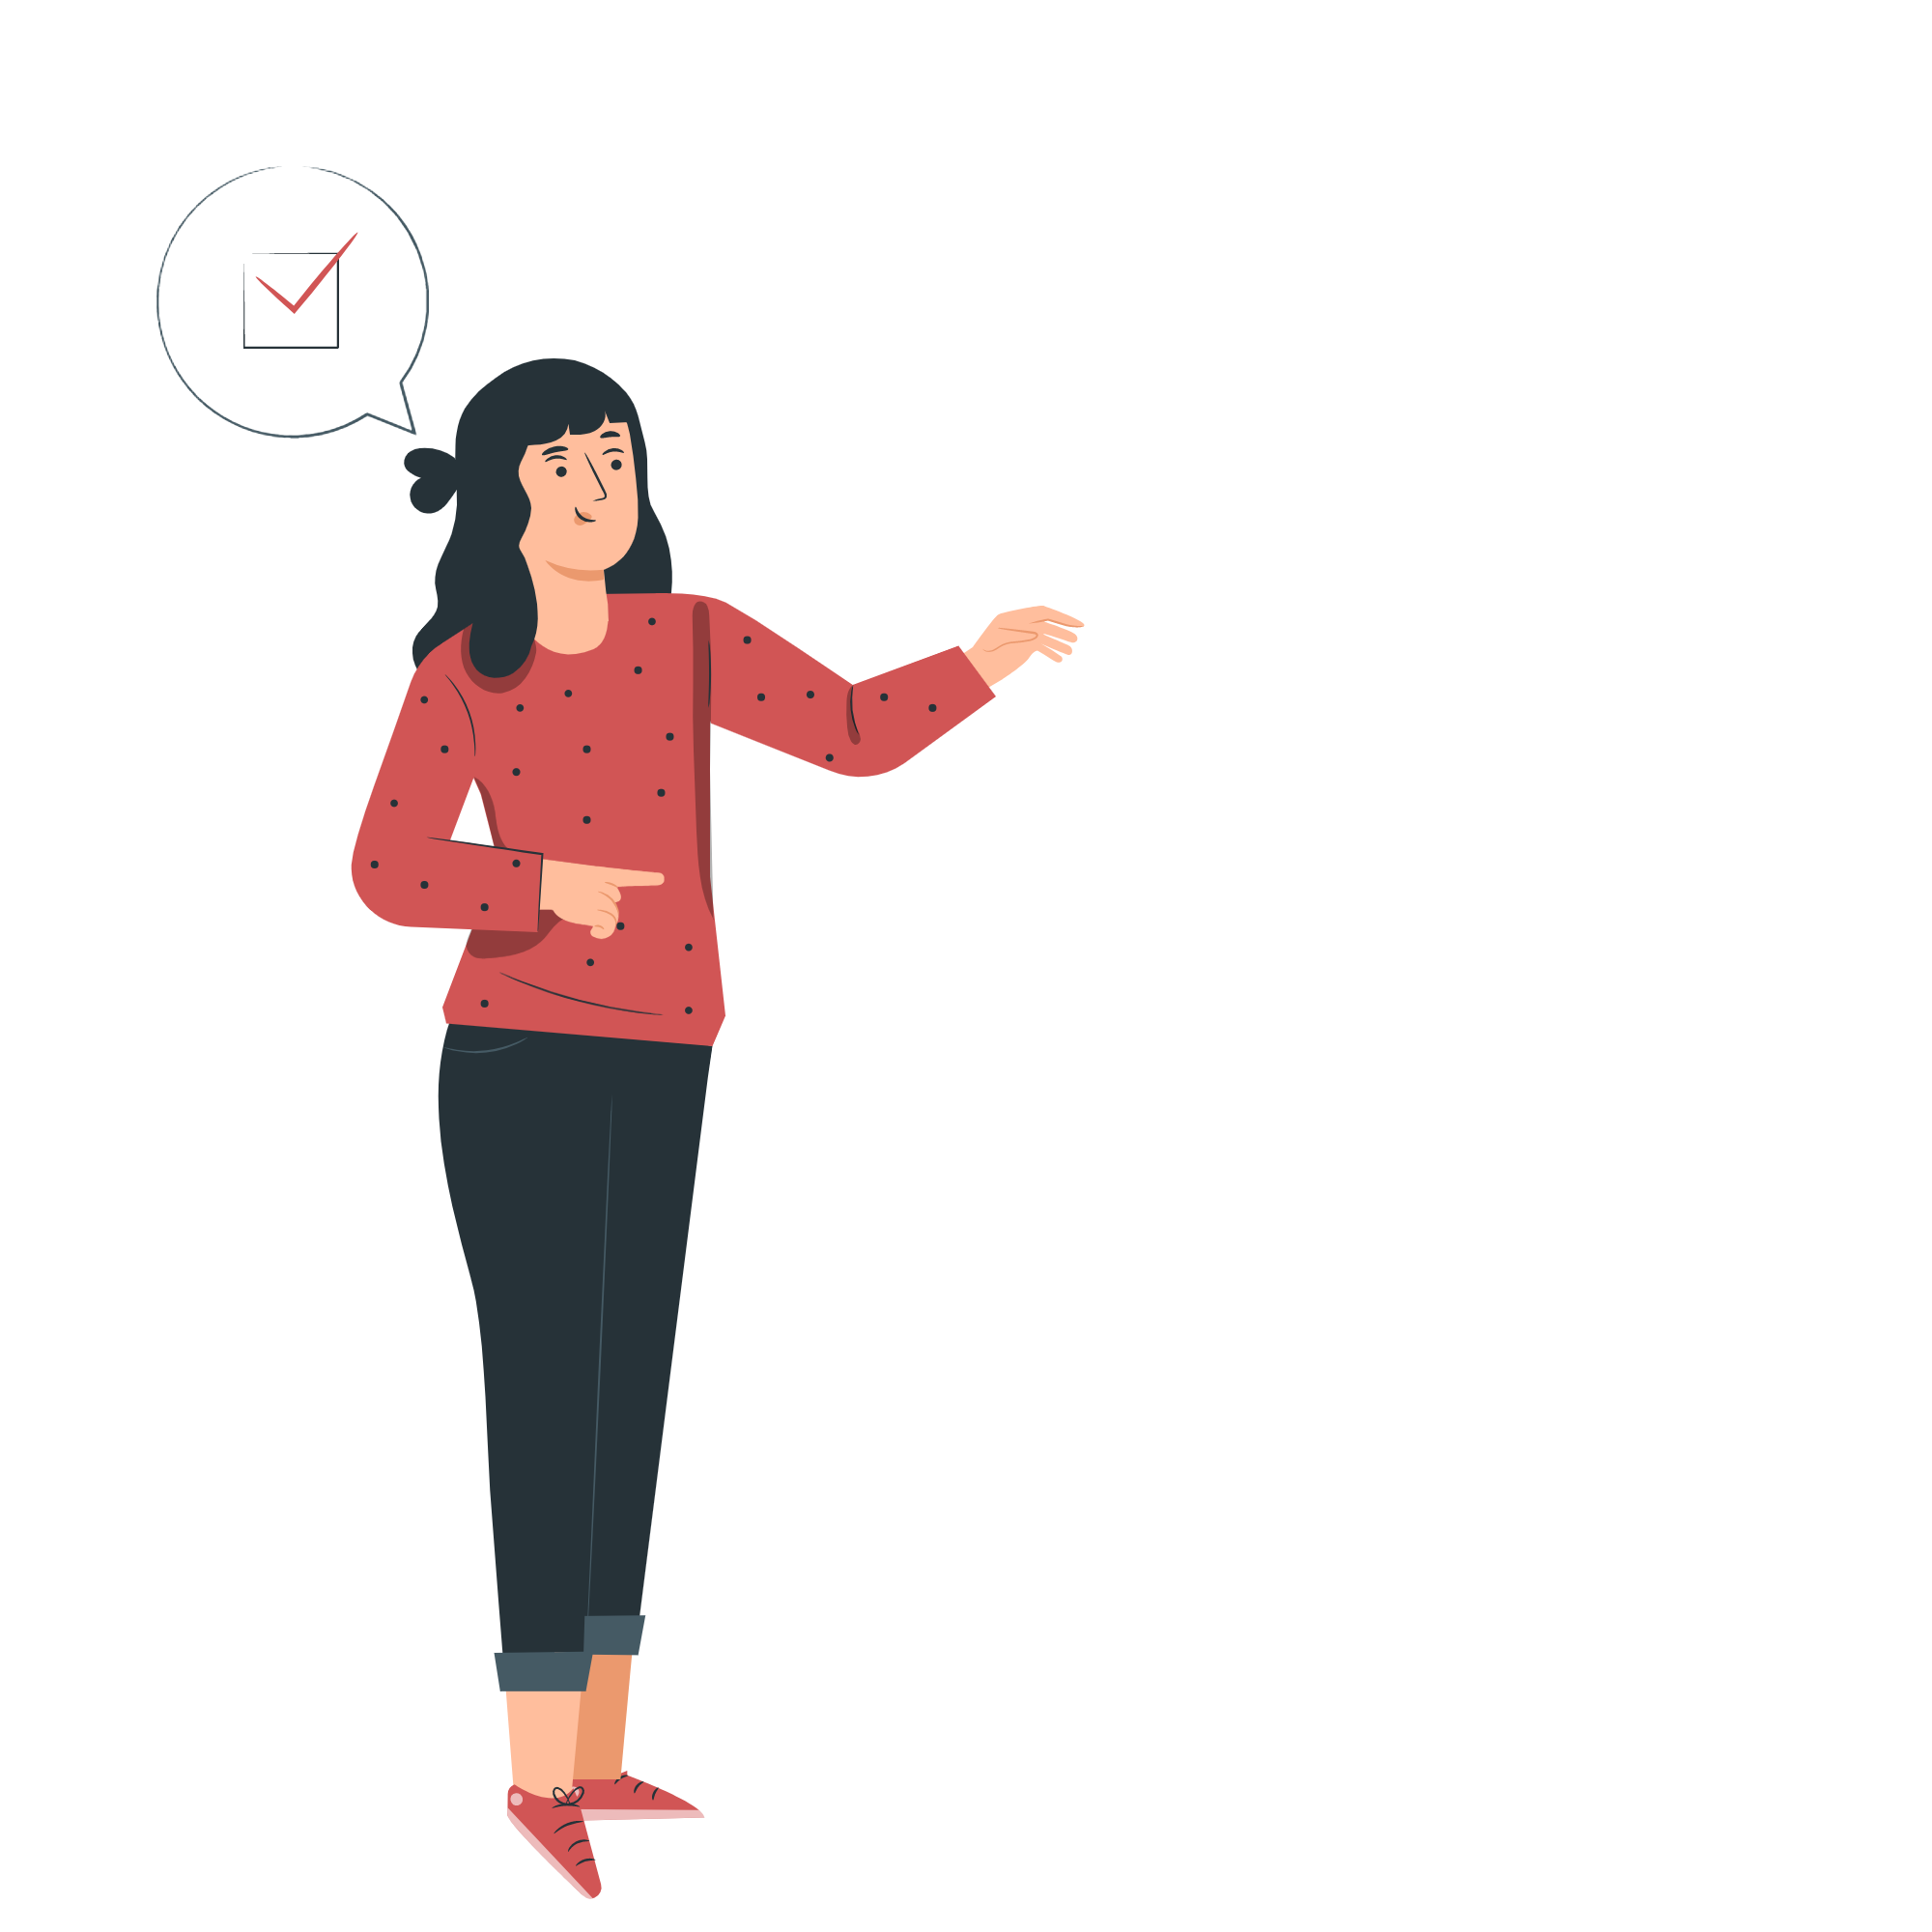
THE APP IN ACTION

Slide 10
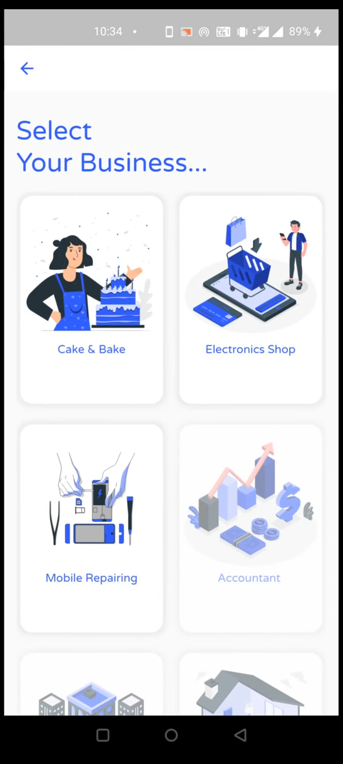
SELECTs HER BUSINESS

Slide 11
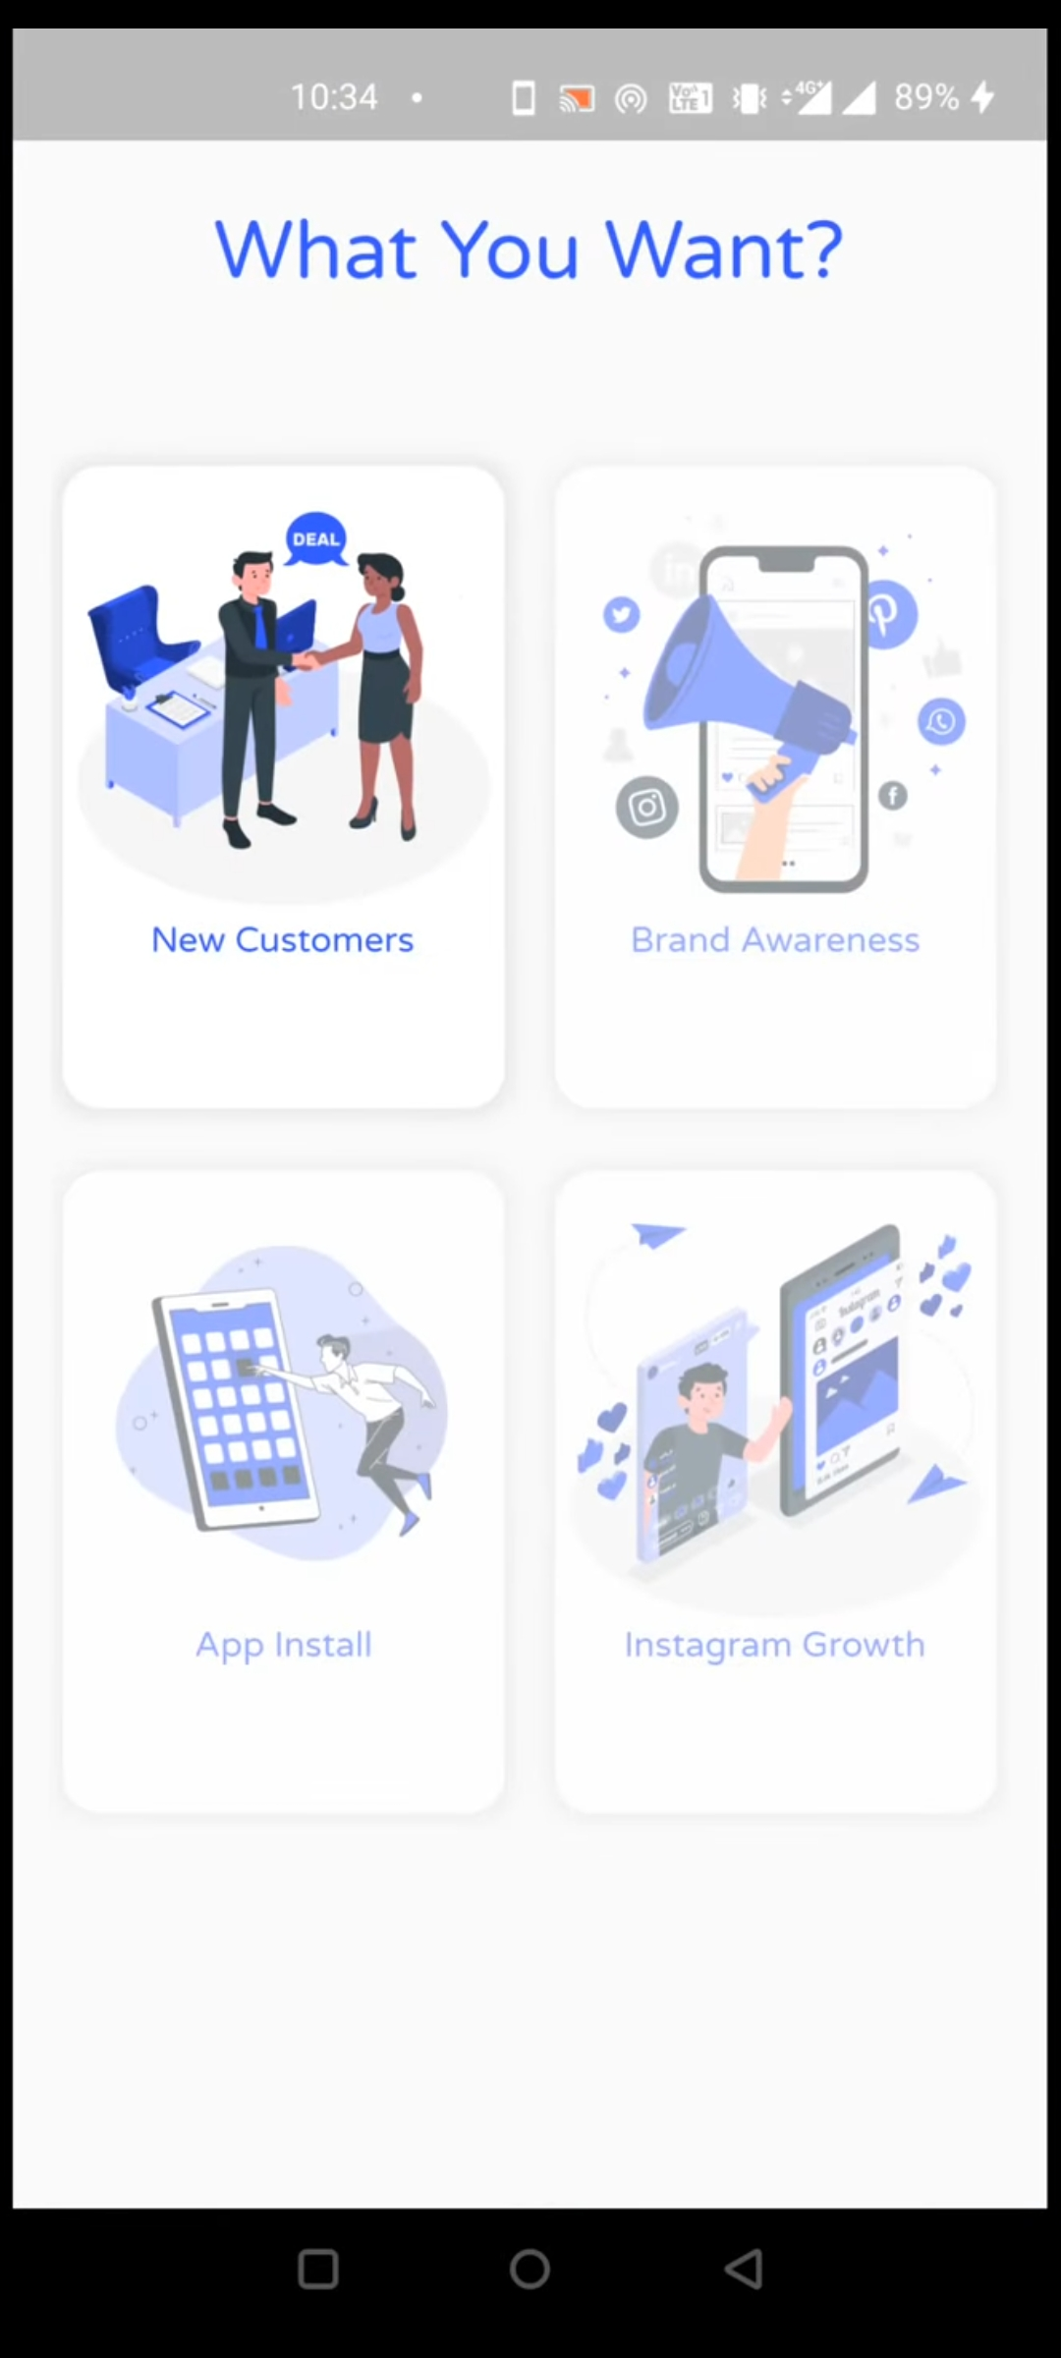
SELECTs HER OBJECTIVE

Slide 12
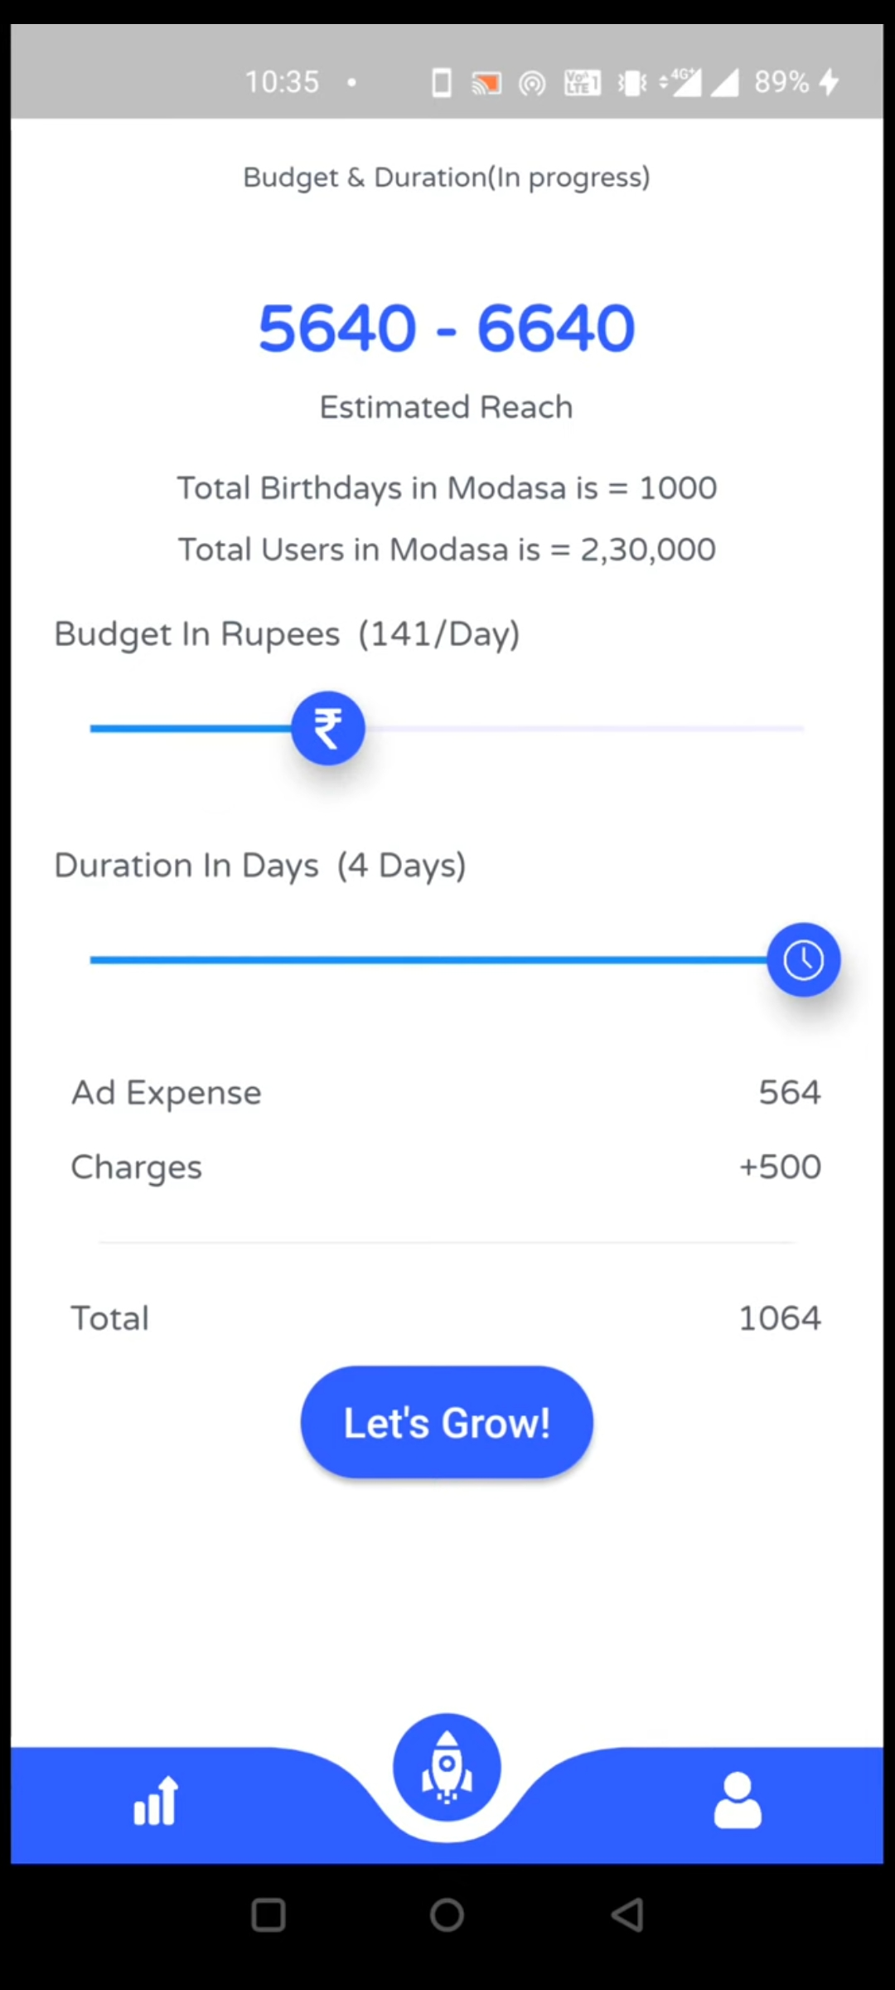

STARTS CAMPAIGN IN ONE TAP

Slide 13
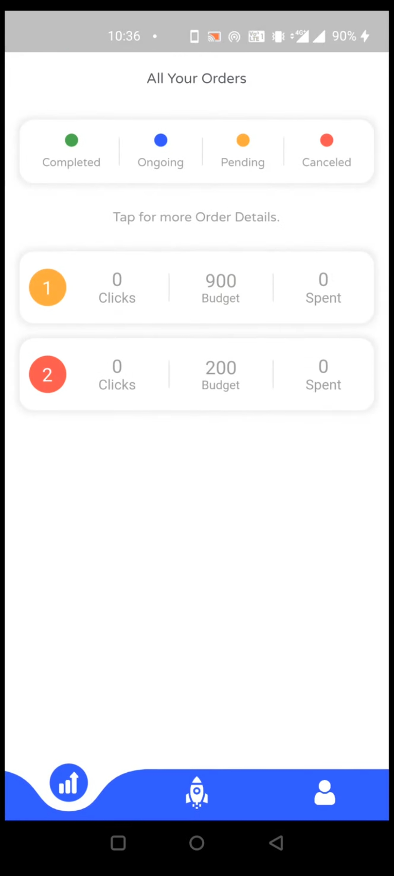
SUSAN’s LIST OF ORDERS

Slide 14
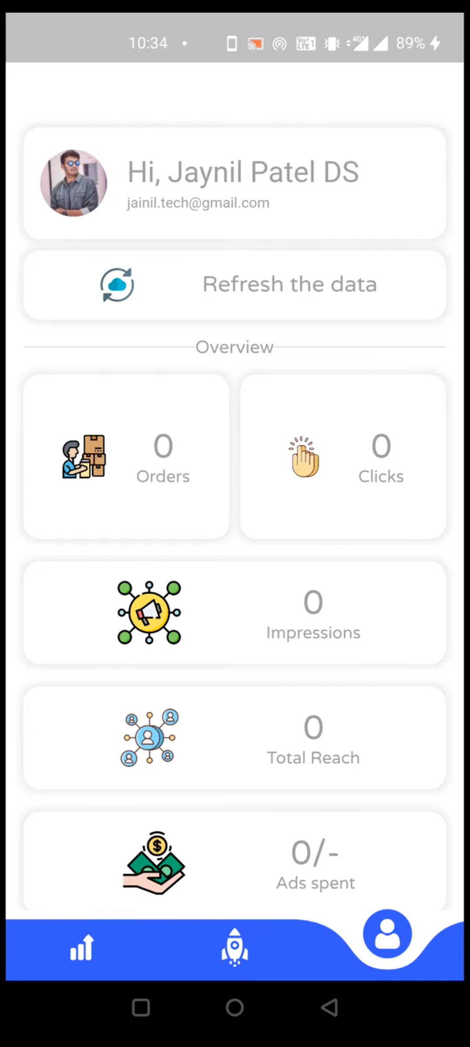
AND HER PROFILE
Hi Susan !

Slide 15

susan connects with a digital marketer
Aditya : Hey Susan! I am a Digital Marketer on Hype360.
I shall take care of your marketing campaign from here on!
Susan : Hey! How can I track my campaign?
Aditya : You shall receive a report on the app daily.

Slide 16
and they discuss…
Susan : OK, And how will my potential customers nearby know about my bakery?
Aditya : We will target the friends of people who have their birthdays this month.
And let them know about the discounts you offer on your cakes.
Susan : That’s Great. Thanks a lot !

Slide 17
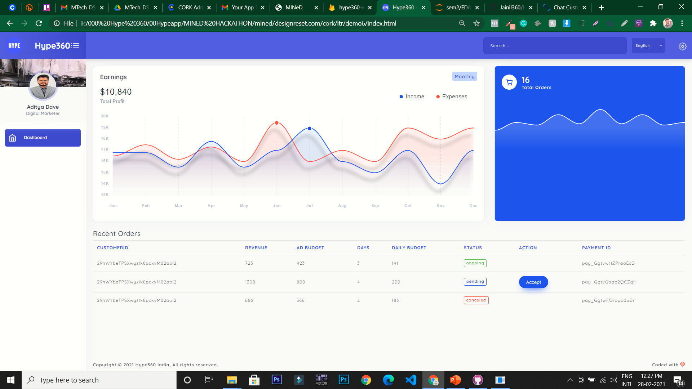
aDITYA’s DASHBOARD

Slide 18
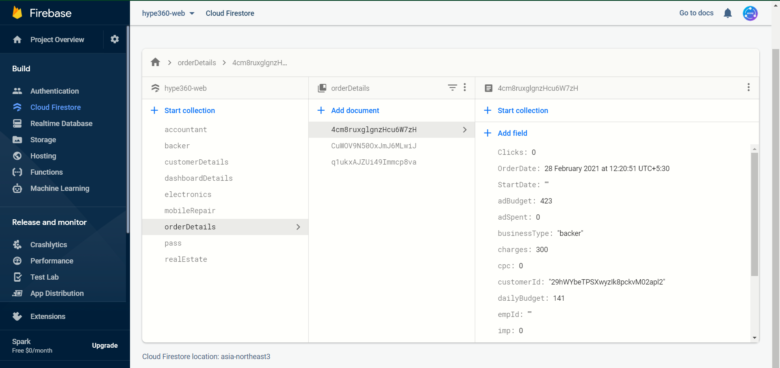
BEHIND THE scenes - DATAbase

Slide 19
Finally…
I can bake in peace.

Slide 20






TECHNOLOGIES WE USED
FLUTTER
Flutter
Firebase Firestore
HTML
CSS
JavaScript
Bootstrap - 4
FIREBASE
JAVASCRIPT
CSS
HTML
BOOTSTRAP 4

Slide 21
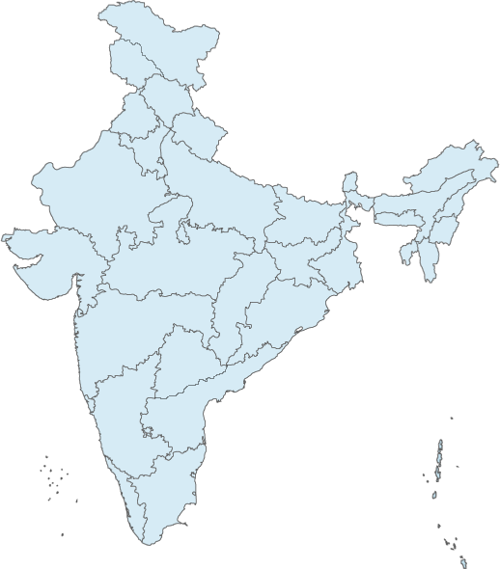
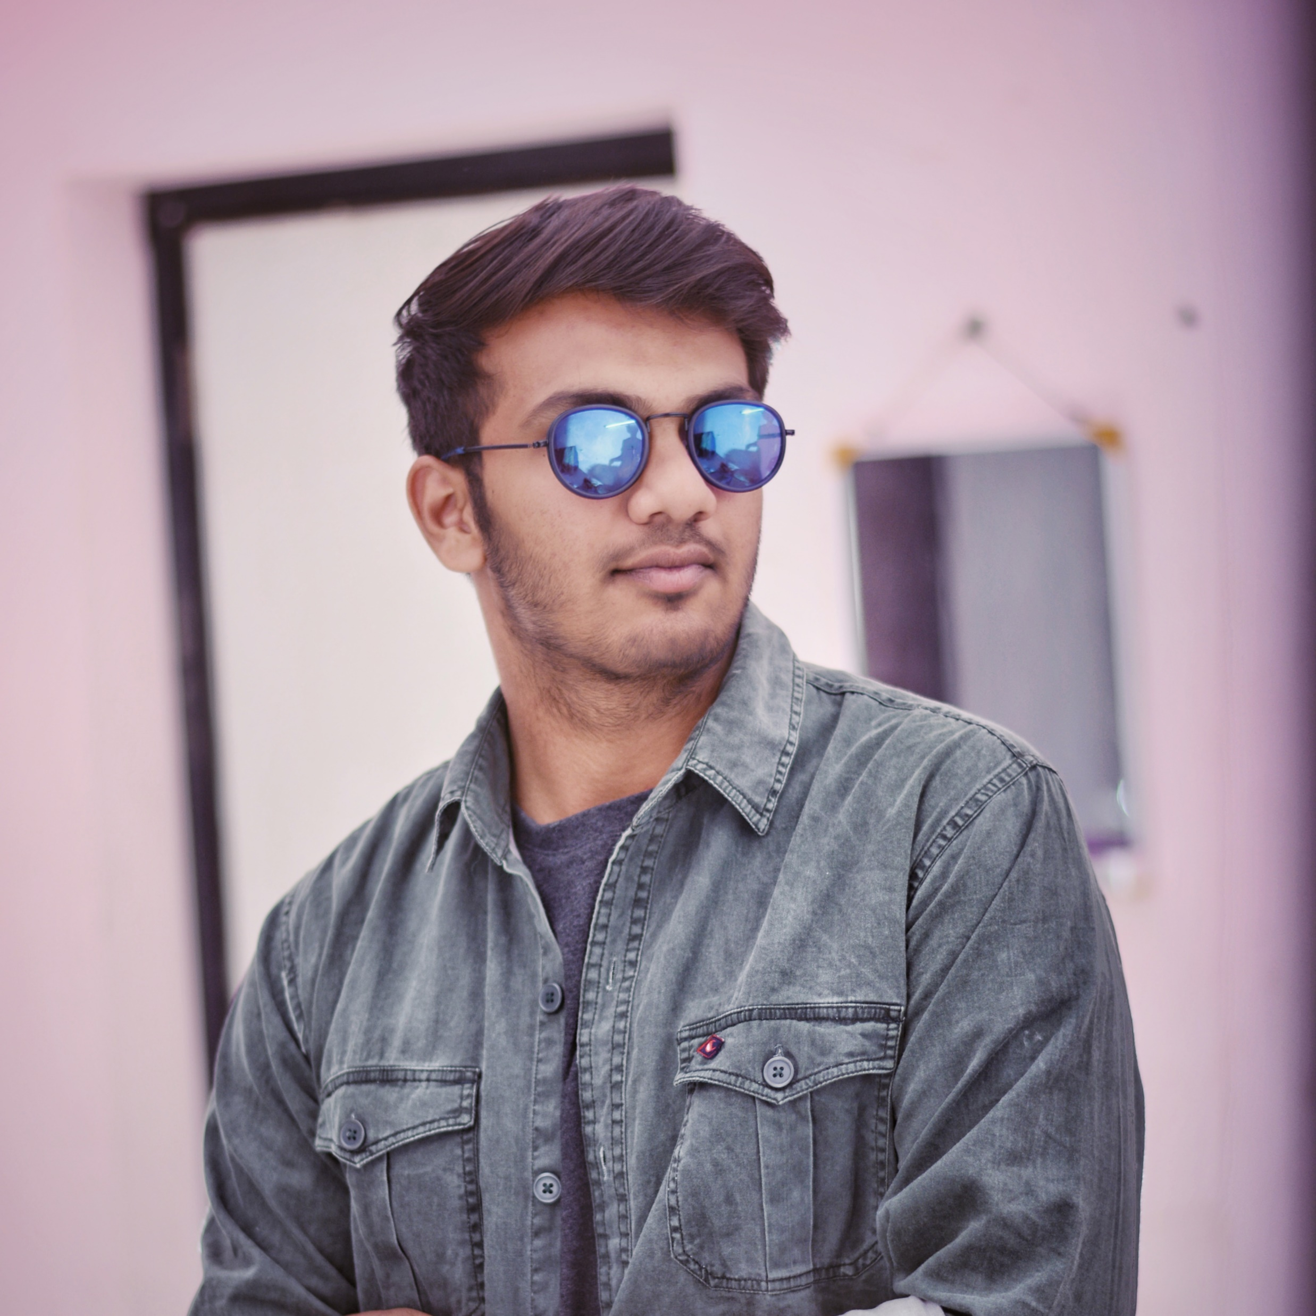
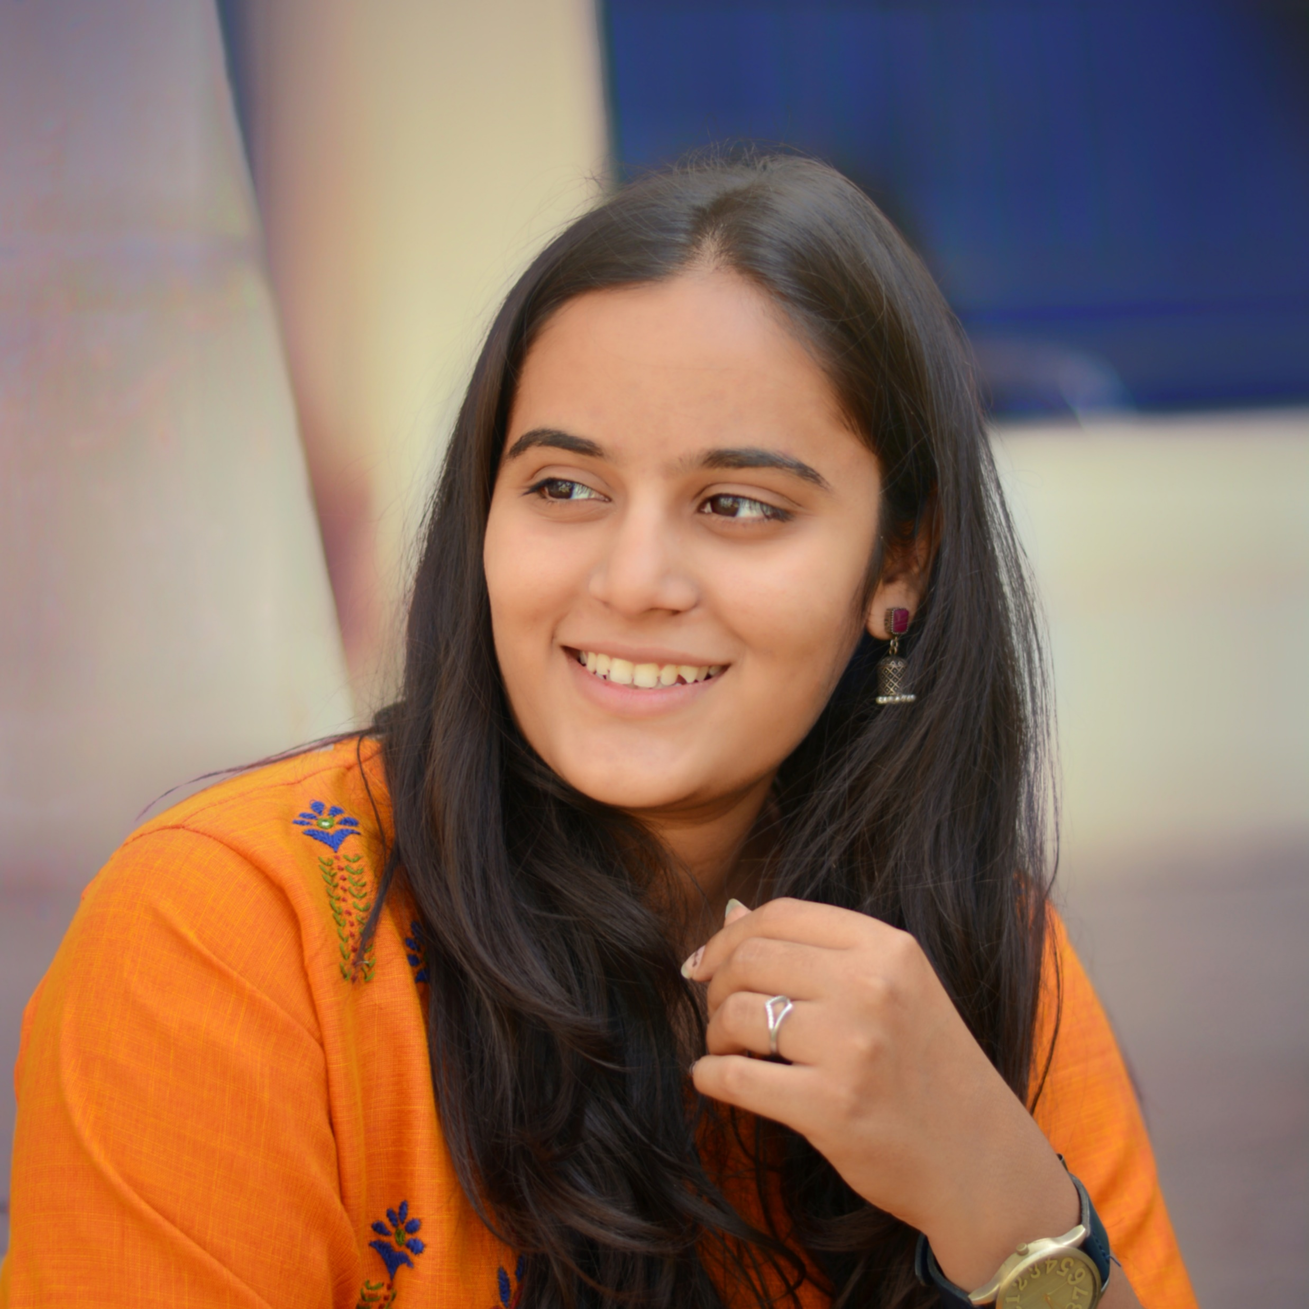
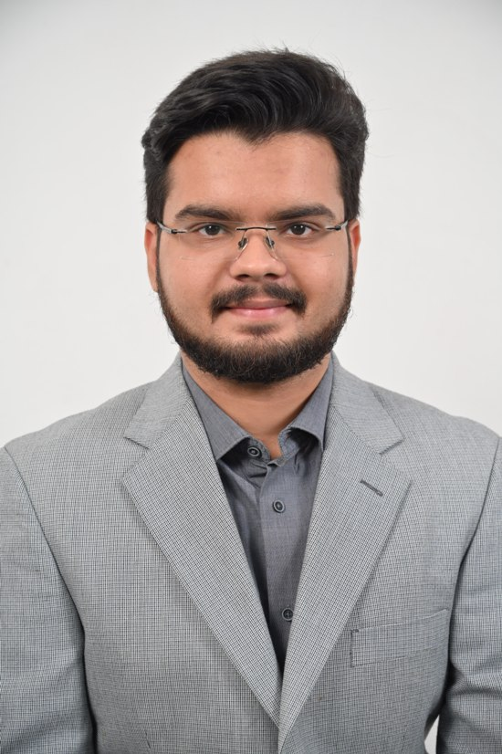
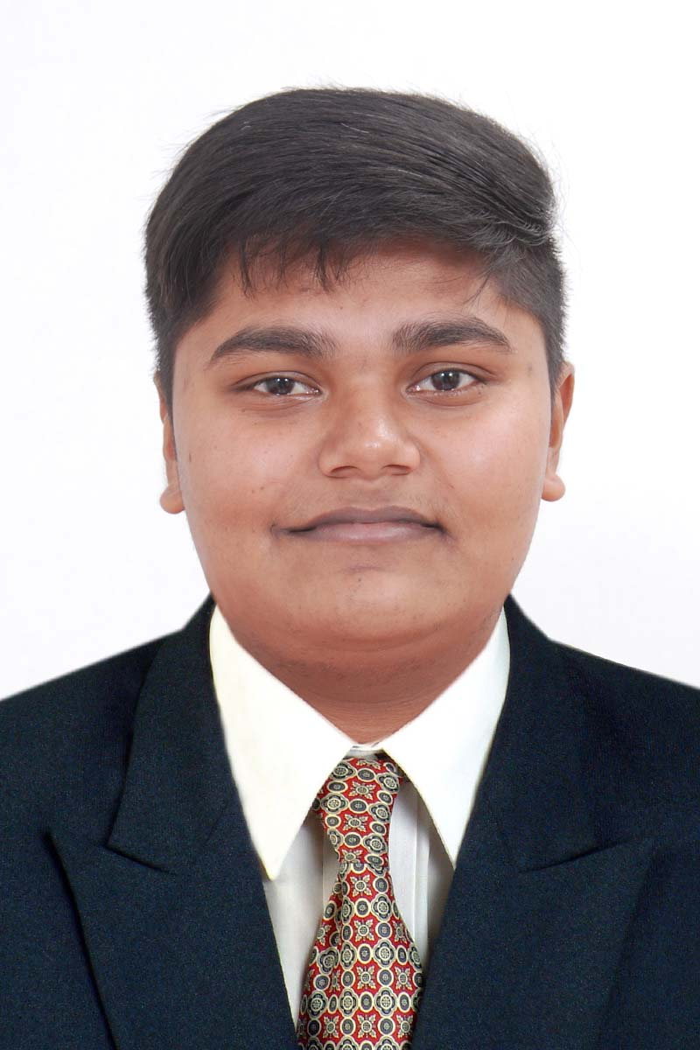
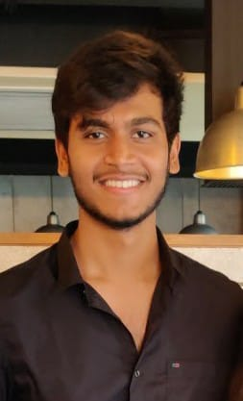
The team
HUGS 4 BUGS
says
THANK YOU !
Jaynil
Patel
Kalgi
Sheth
Aditya
Dave
Vatsal
Shah
Dhrumil
Shah

Slide 22
01
02
03
04
05
06
BRIEF SUMMARY
OUR GOAL
OBJECTIVE
Make Marketing Easier For All
Build “One Of Its Kind” Aggregator Platform
INNOVATION
Personalised Marketing
Appx. Reach Predictor at your finger tips
One Stop Solution
Modules
The APP
Digital Marketer’s Dashboard
Manager’s Dashboard
Tech Stack
Future scope
Flutter
Firebase
HTML
CSS
Bootstrap-4
JS
Automate Reporting using Marketing APIs
Include Target-Audience-Analytics for clients

